Slide 1
Wine Tasting Predictions

Slide 2
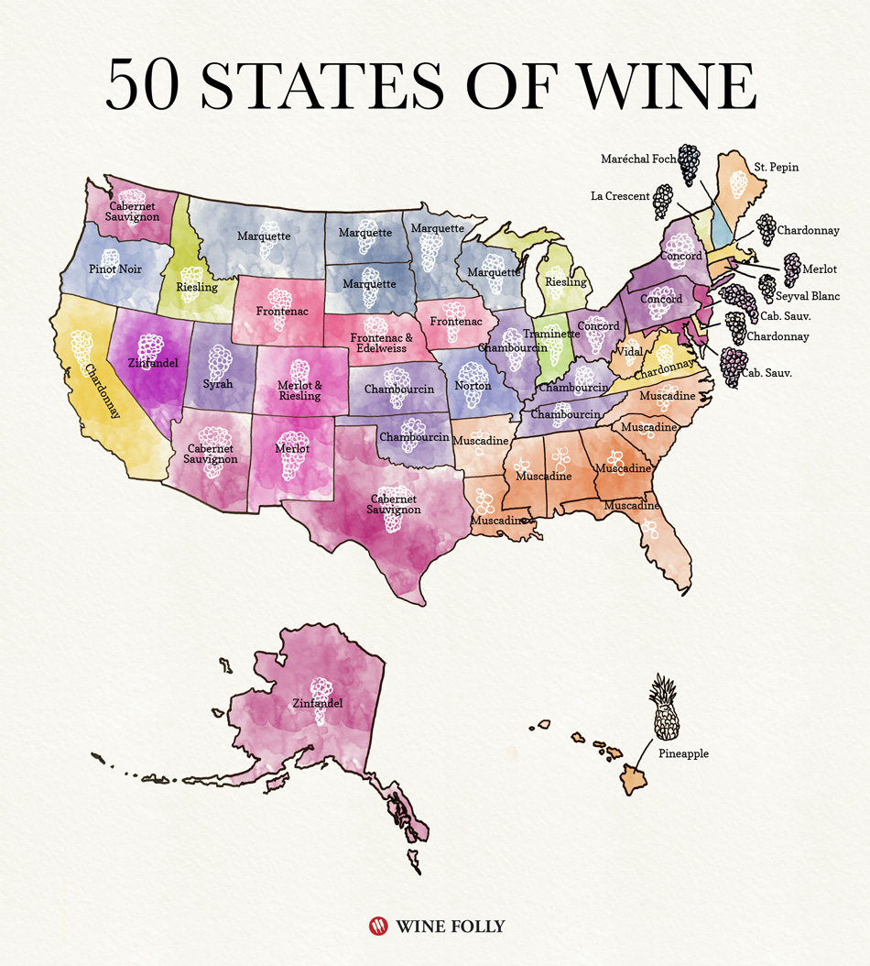

Introduction
sour
Source: Wine Folly

Slide 3
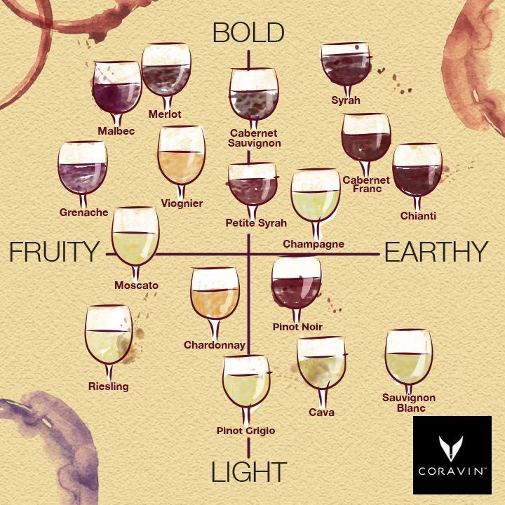
WINE ATTRIBUTES
Source: Coravin

Slide 4
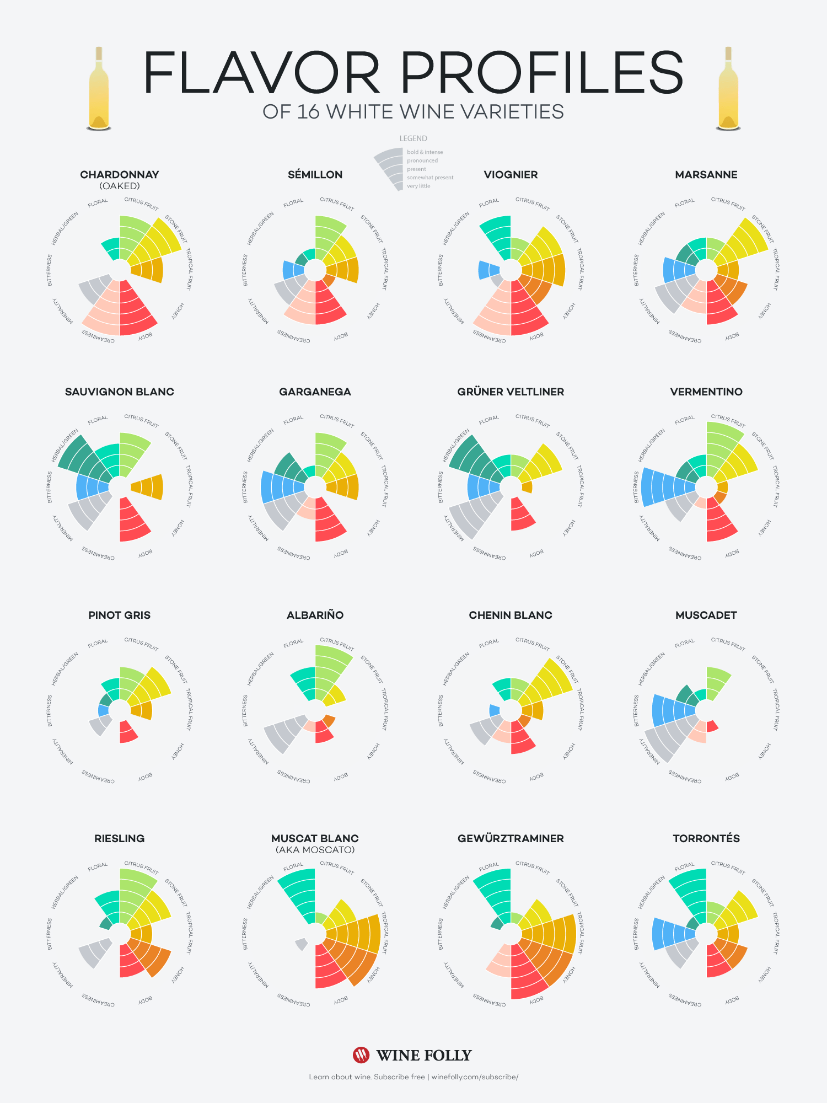
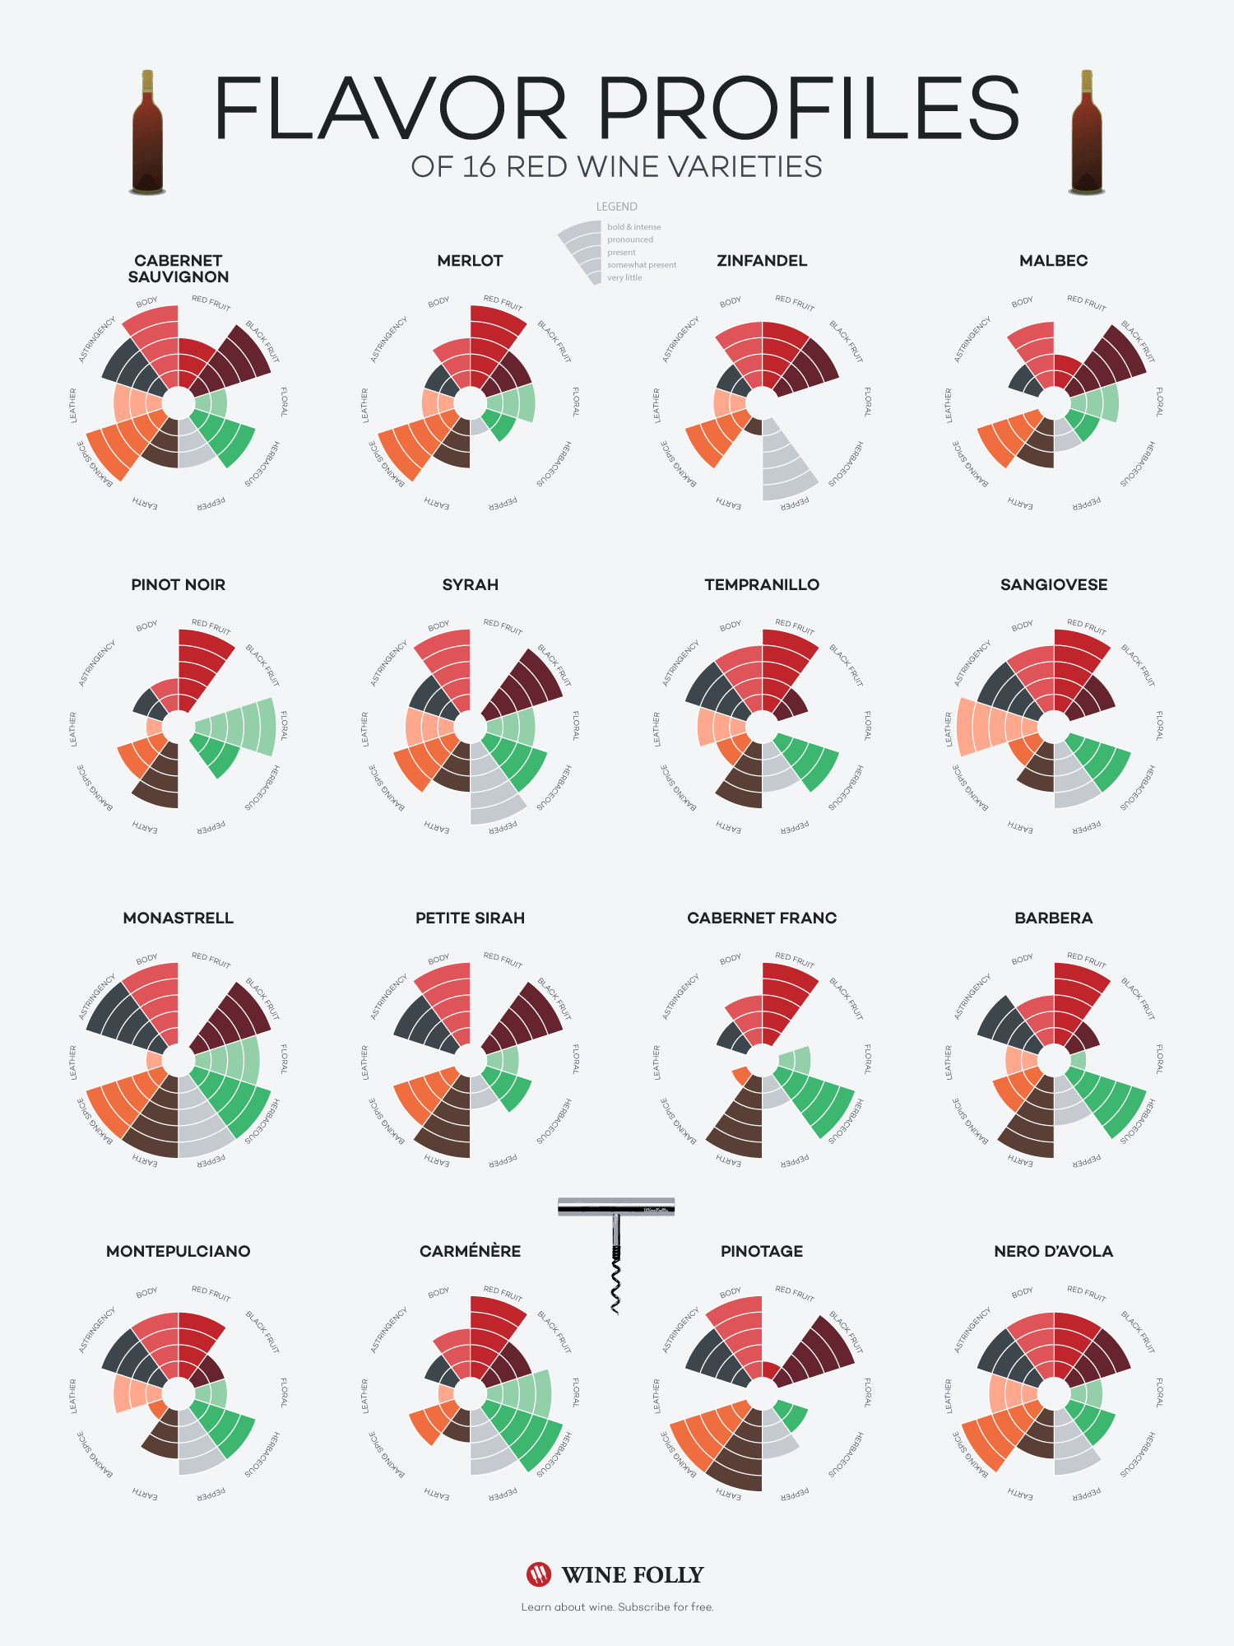
Background of the Problem
Source: Wine Folly

Slide 5
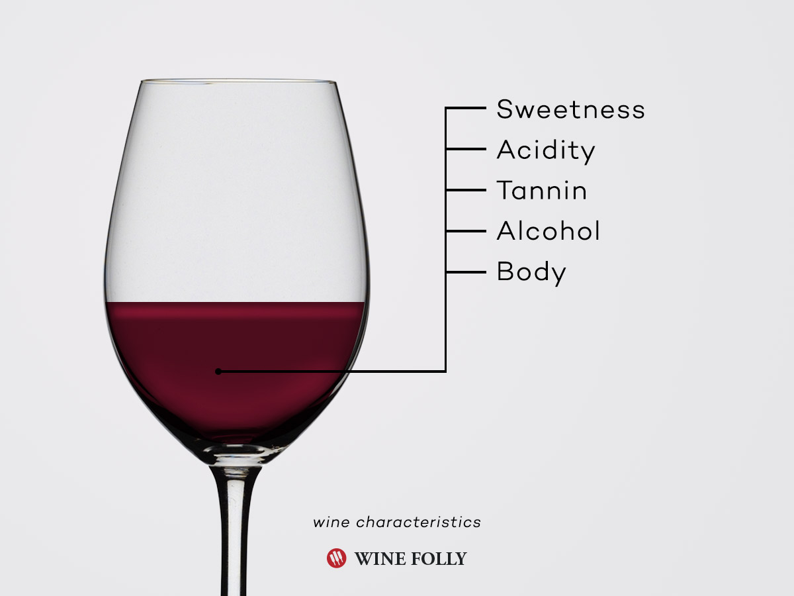
DATA UNDERSTANDING
Source: Wine Folly

Slide 6
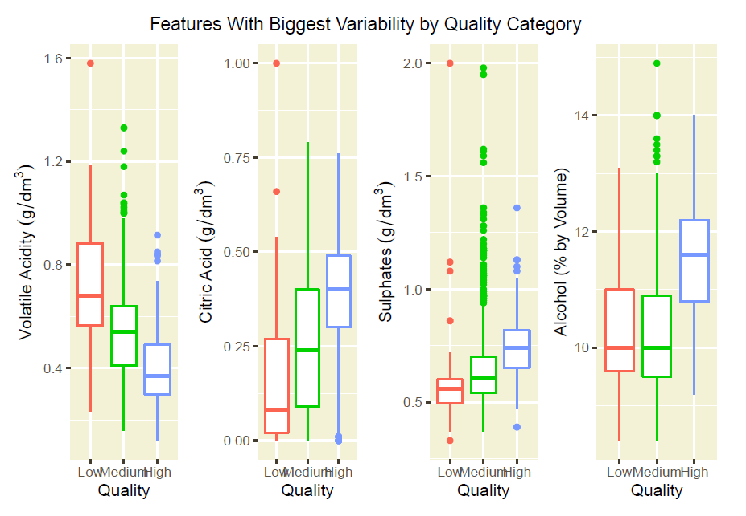
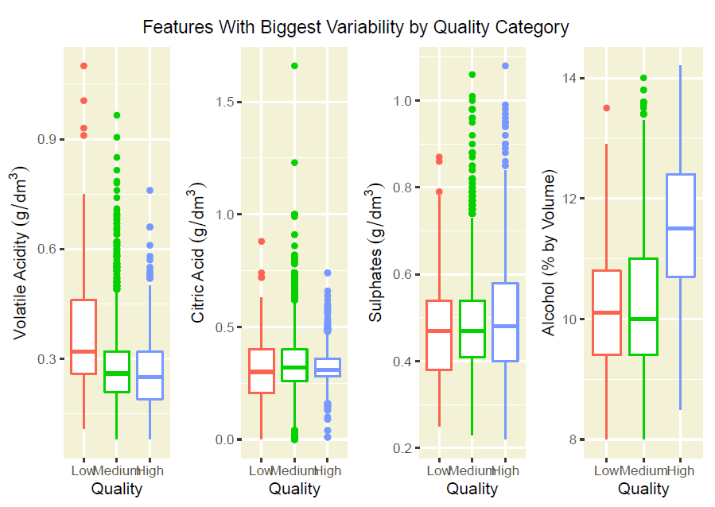
METHODS
Red Wine Variables
White Wine Variables

Slide 7
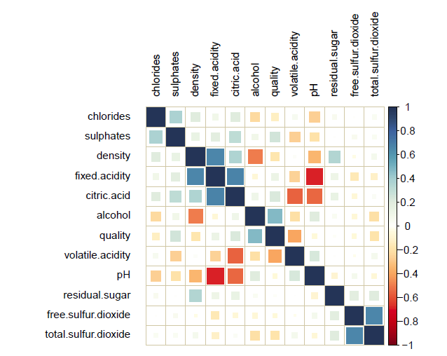
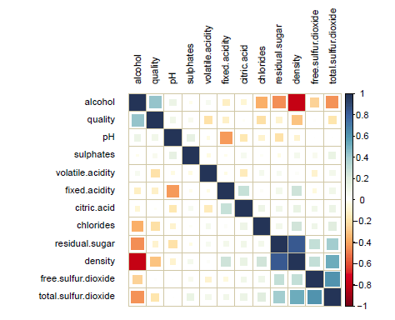
METHODS
Red Wine Correlation Matrix
White Wine Correlation Matrix

Slide 8
Modeling and Results WITH r
Binomial logistic regression models
Training set accuracy: 77% red wine, 77% white wine
Testing set accuracy: 75% red wine, 78% white wine
Best variables:
Free sulfur dioxide
Density
Sulphates
Residual sugar
Alcohol
Volatile acidity

Slide 9
Modeling and Results WITH PYTHON
Linear regression models
Training set accuracy: 65% red wine, 75% white wine
Testing set accuracy: 63% red wine, 76% white wine
Best variables:
Sulfates have positive correlation for red wine quality
volatile acidity, density have negative correlation for red wine quality
Sulfates, ph have positive correlation for white wine quality
Volatile acidity, density have negative correlation for white wine quality

Slide 10

CONCLUSION

Slide 11
references
Puckette, M. (2016, September 5). 50 States of Wine (Map). Retrieved from Wine Folly: https://winefolly.com/lifestyle/50-states-of-wine-infographic/
Coravin. (2020, May 24). Coravin. Retrieved from Coravin: https://www.coravin.com/?utm_content=buffer4659d&utm_medium=social&utm_source=pinterest.com&utm_campaign=buffer
Puckette, M. (2019, November 17). Flavor Profiles of White Wines. Retrieved from Wine Folly: https://winefolly.com/tips/flavor-profiles-of-white-wines/
Puckette, M. (2016, January 22). Red Wines From Lightest to Boldest. Retrieved from Wine Folly: https://winefolly.com/tips/the-spectrum-of-boldness-in-red-wines-chart/
Puckette, M. (2020, April 8). How Basic Wine Characteristics Help You Find Favorites. Retrieved from Wine Folly: https://winefolly.com/deep-dive/wine-characteristics/

